Slide 1
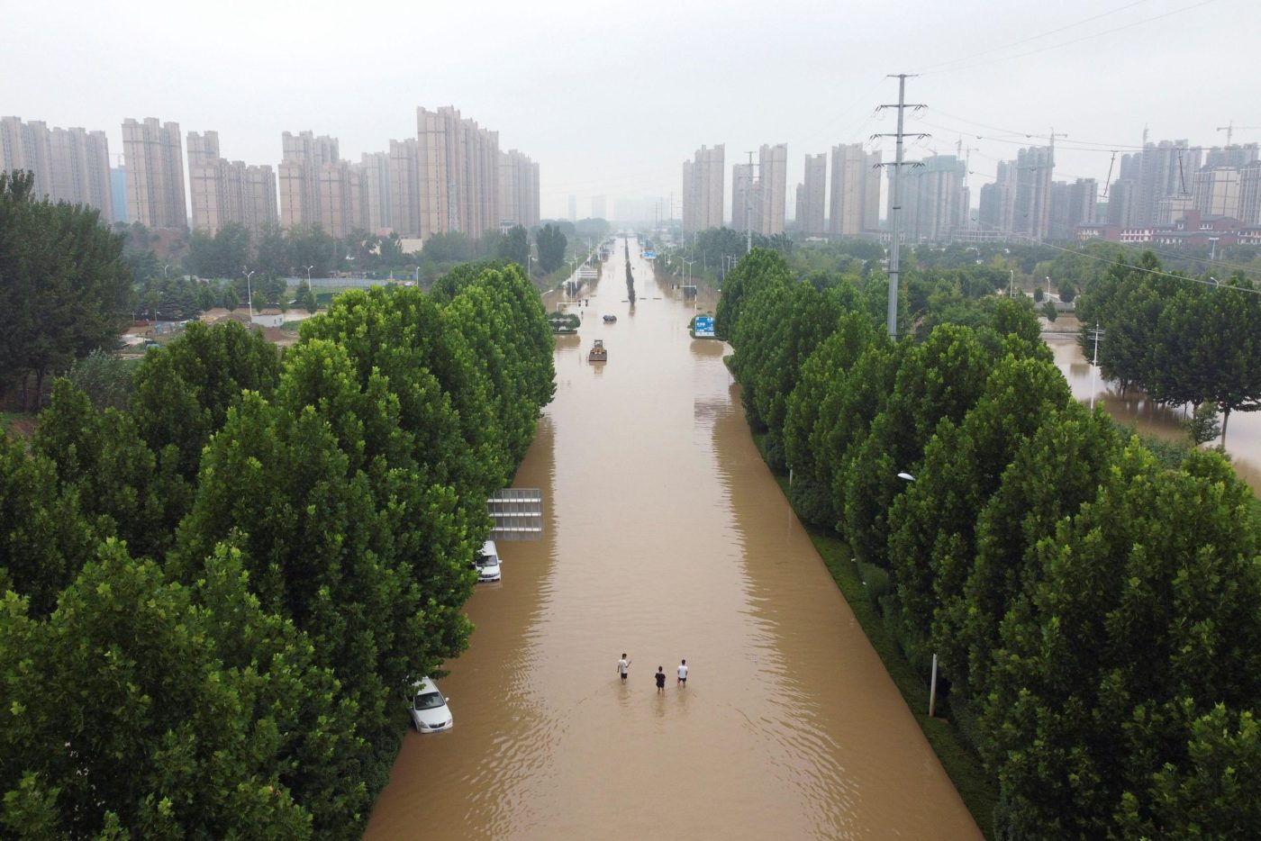
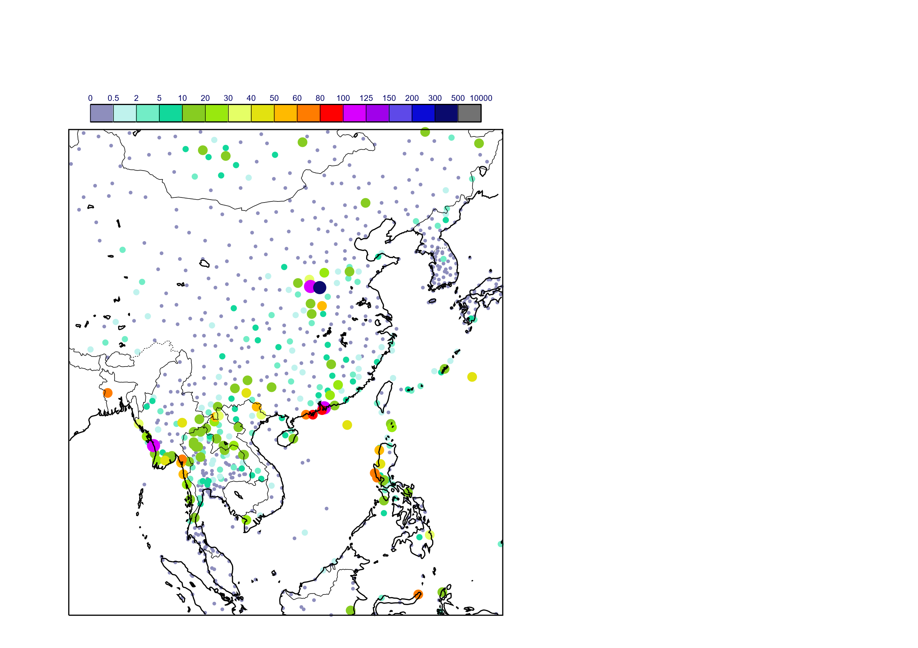

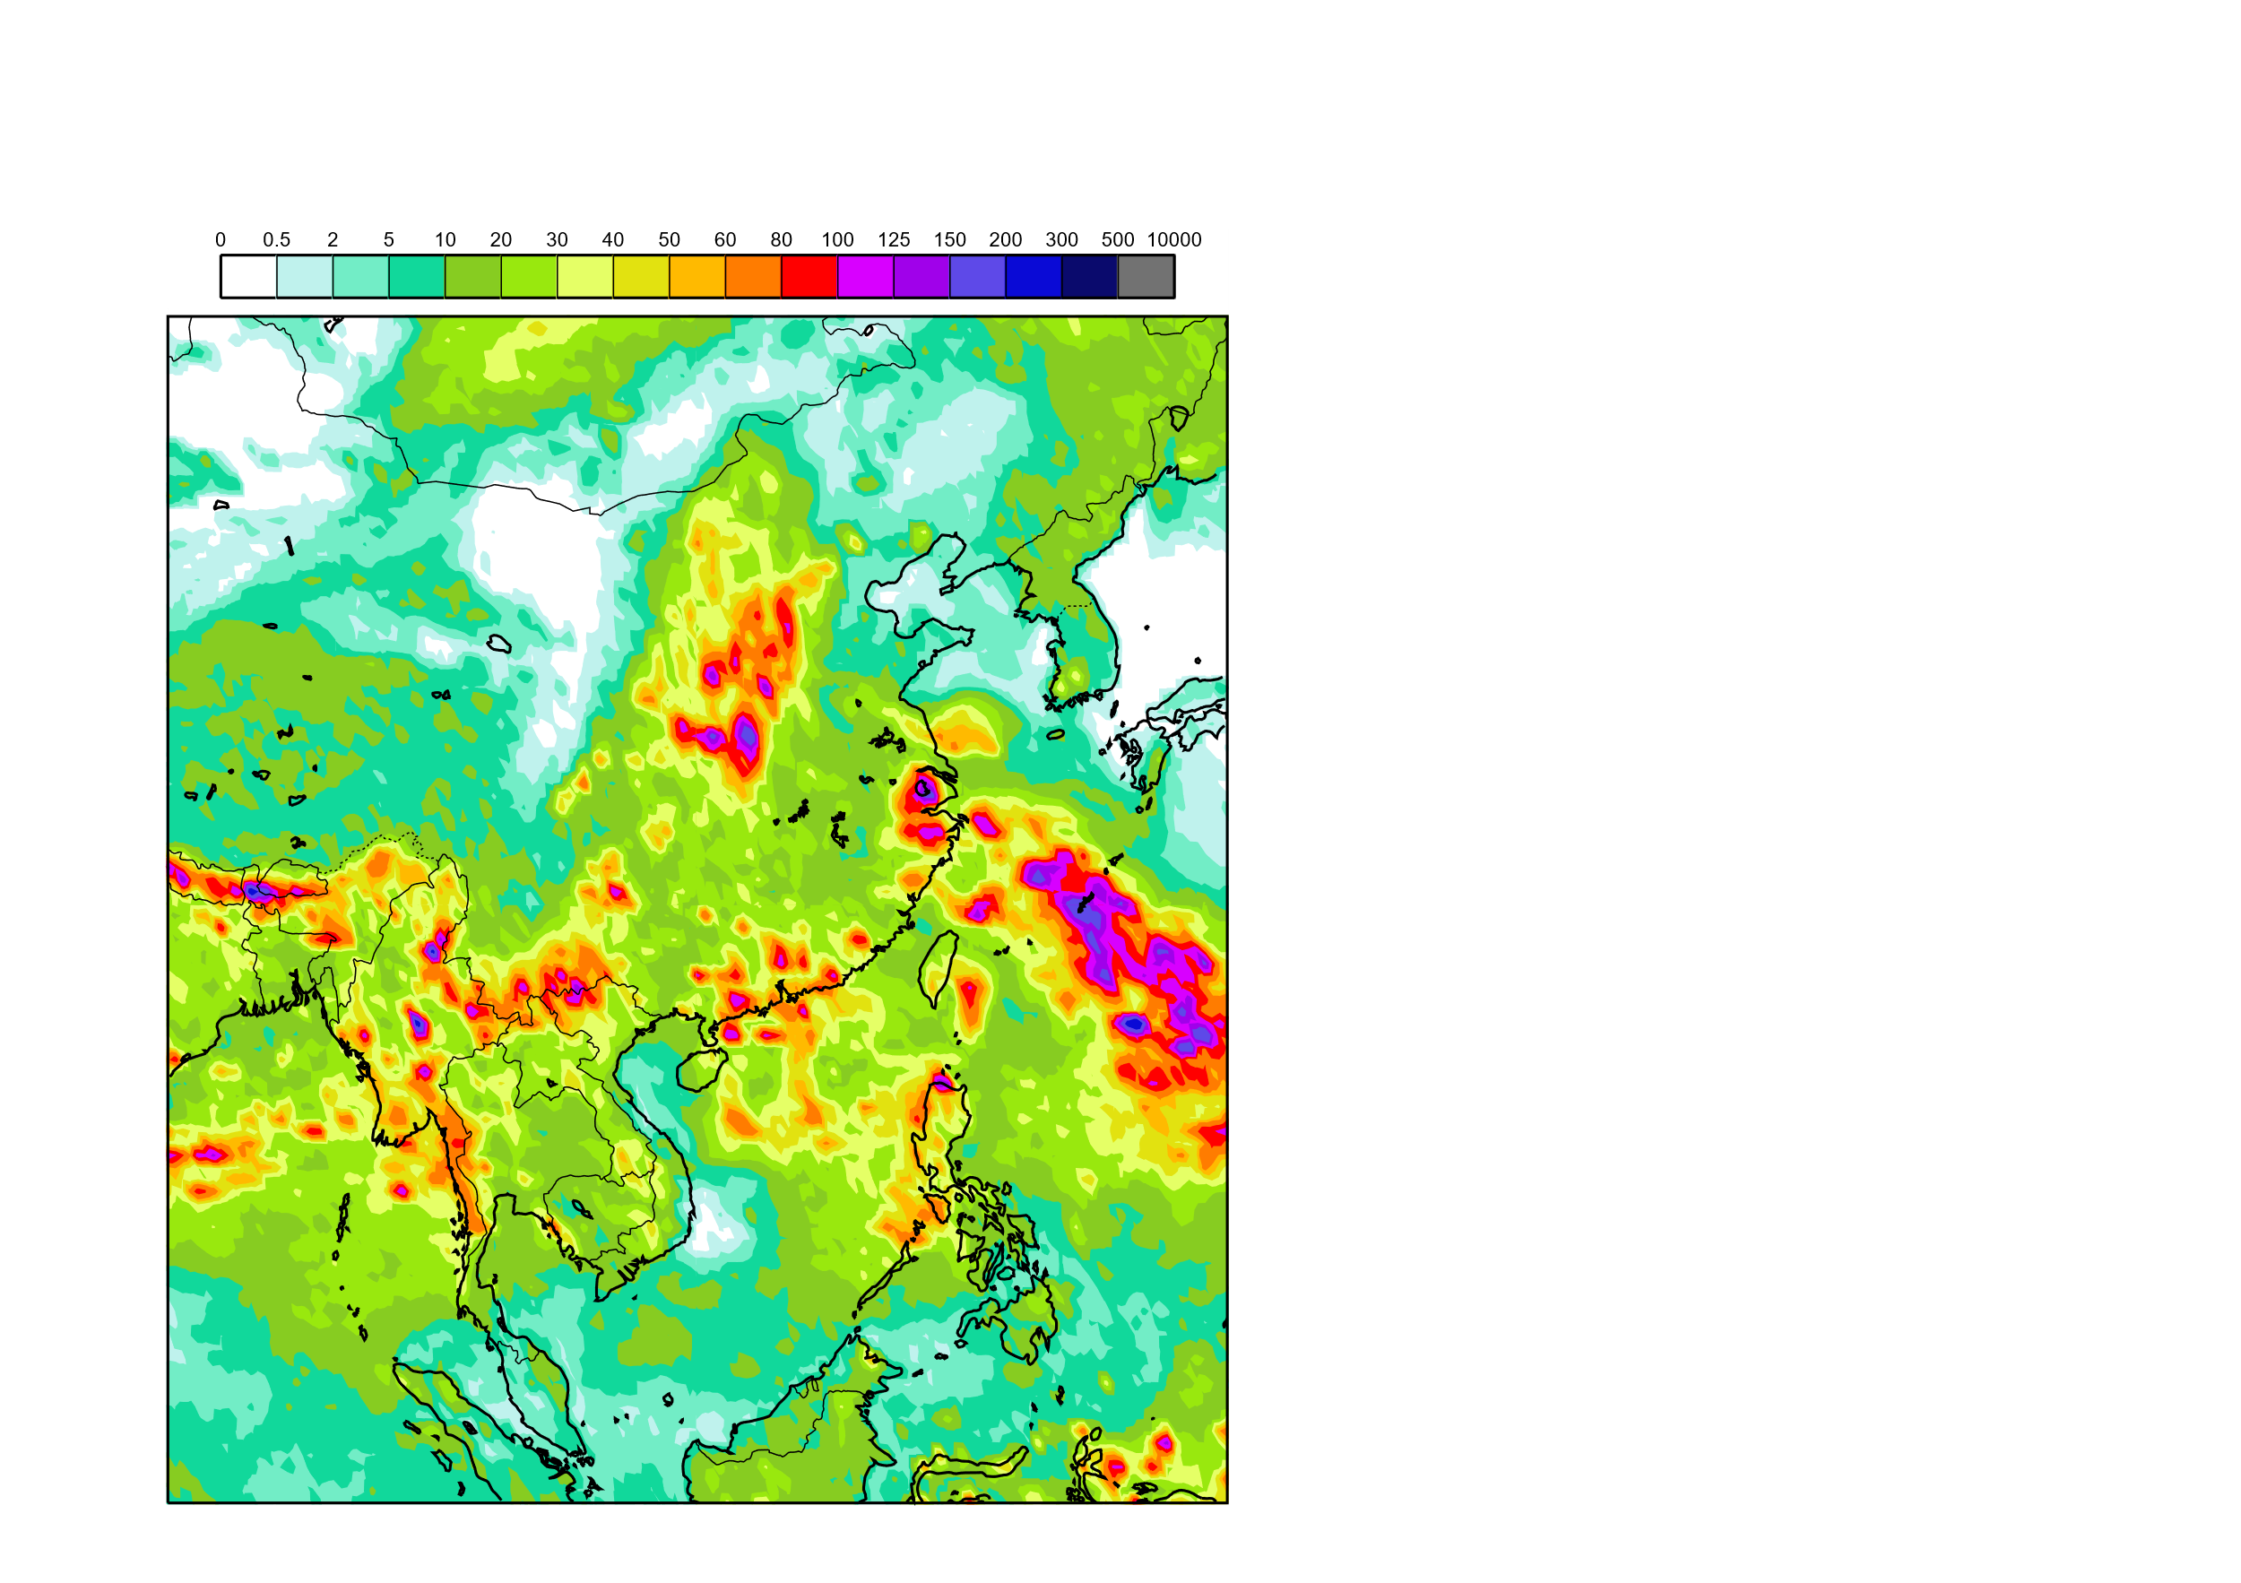
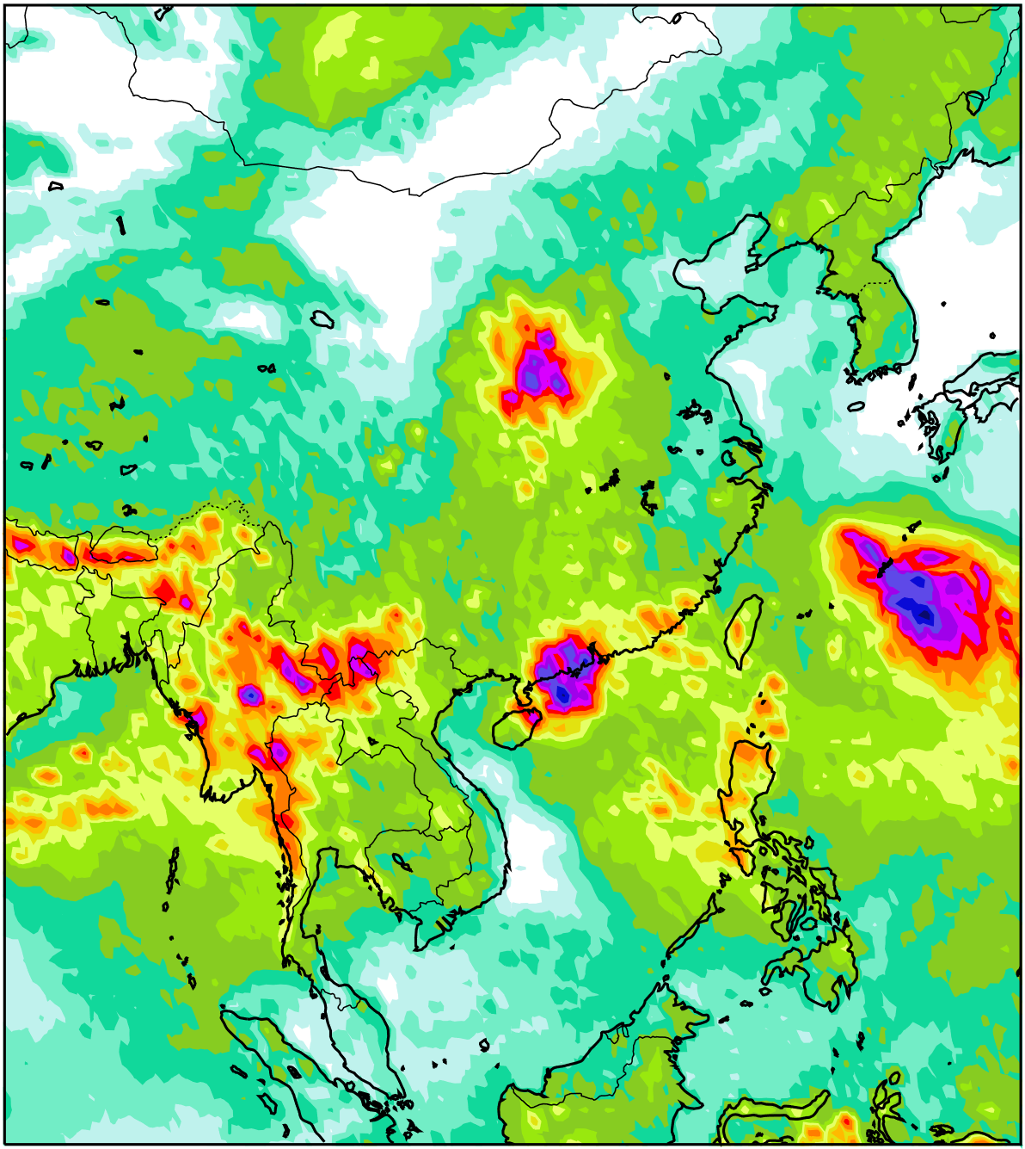
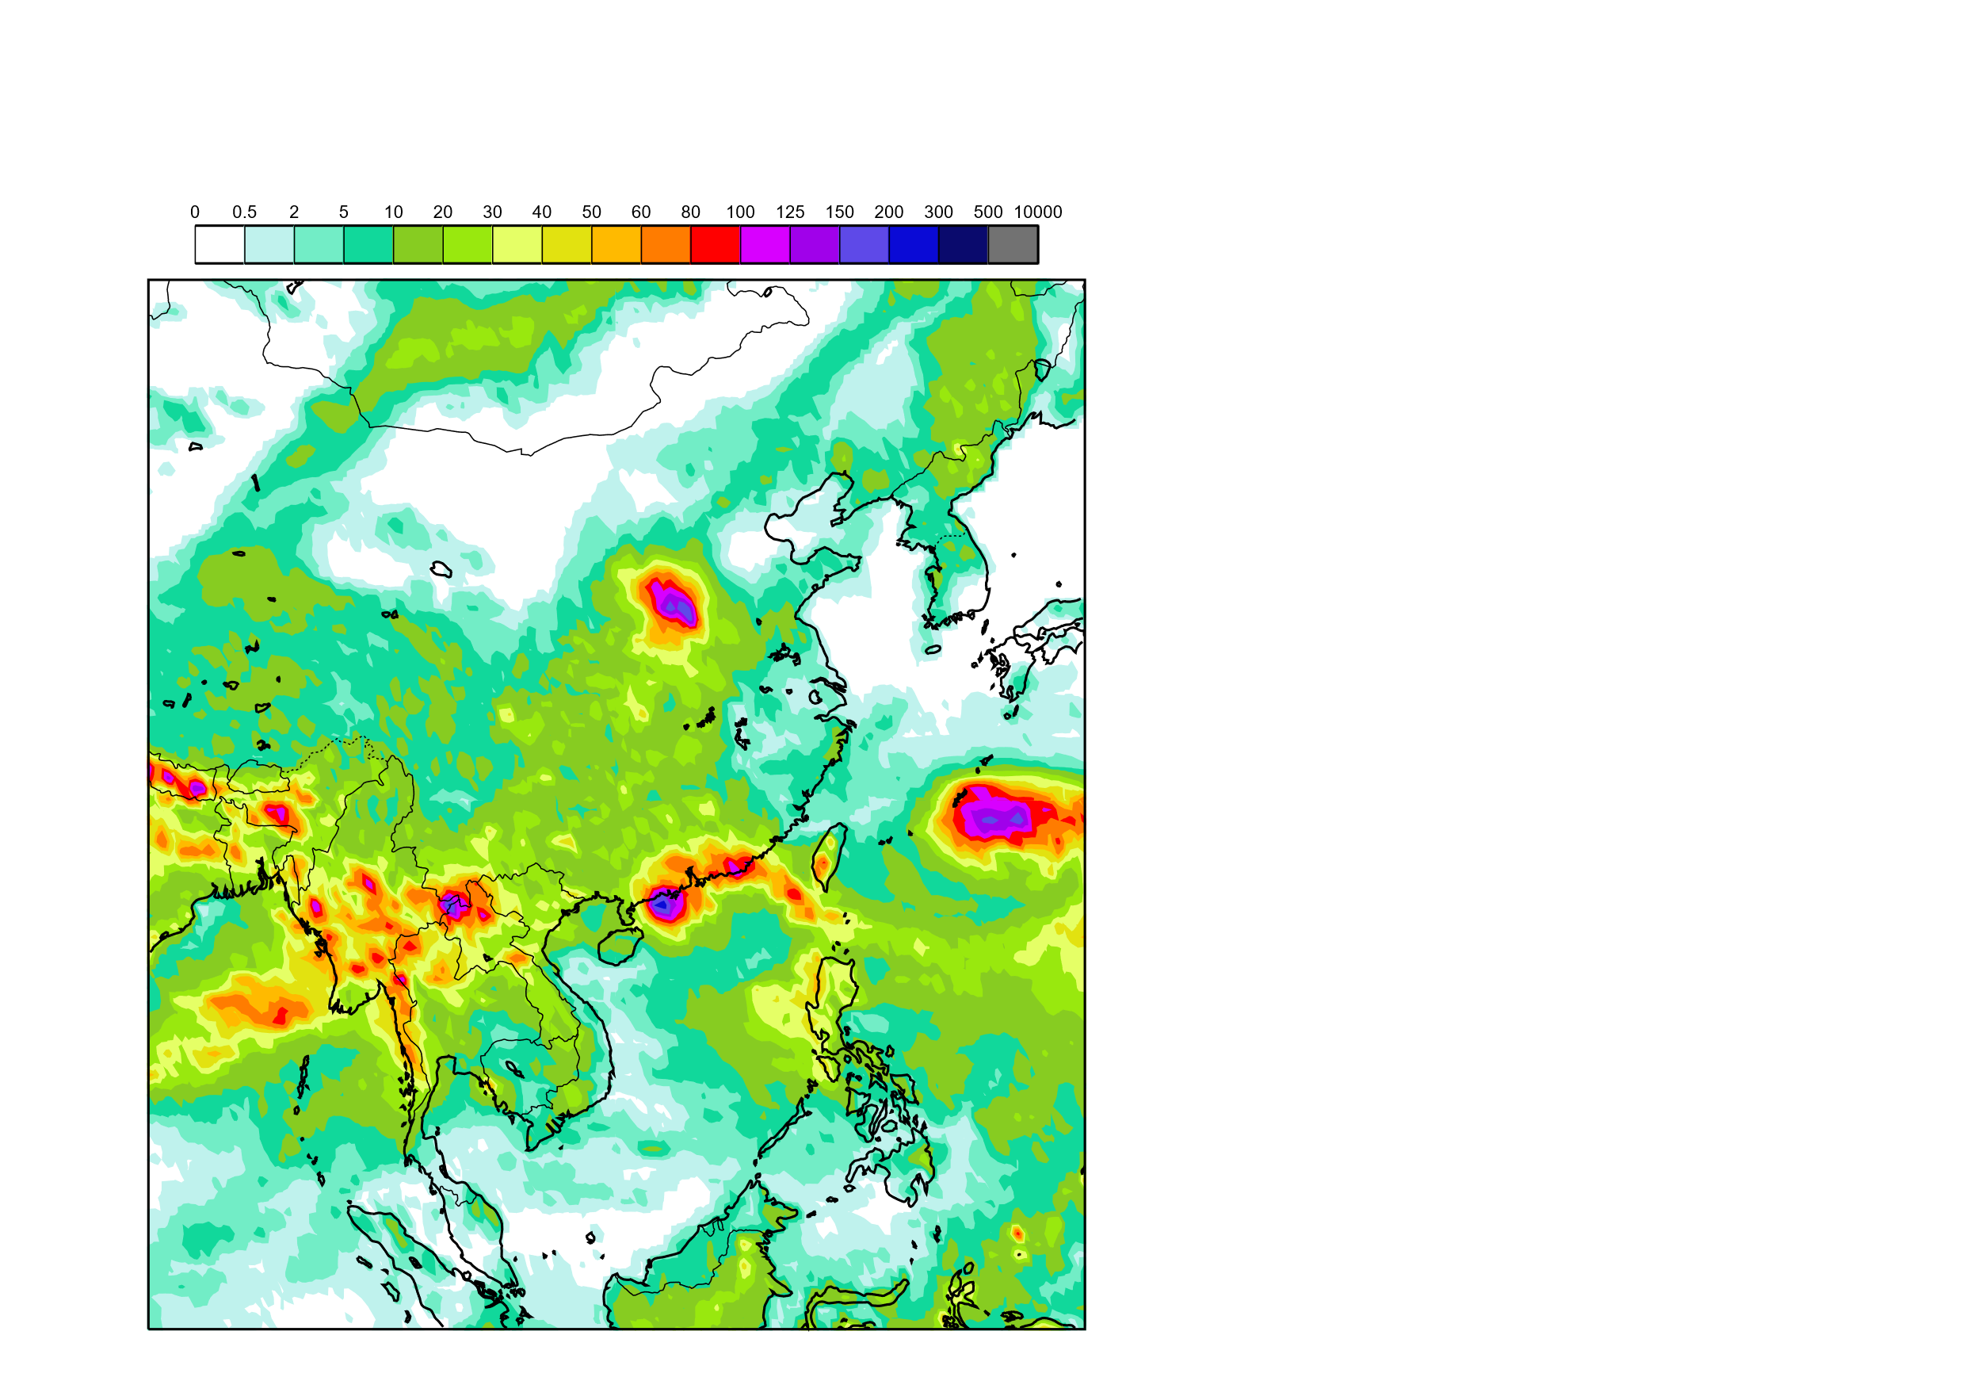
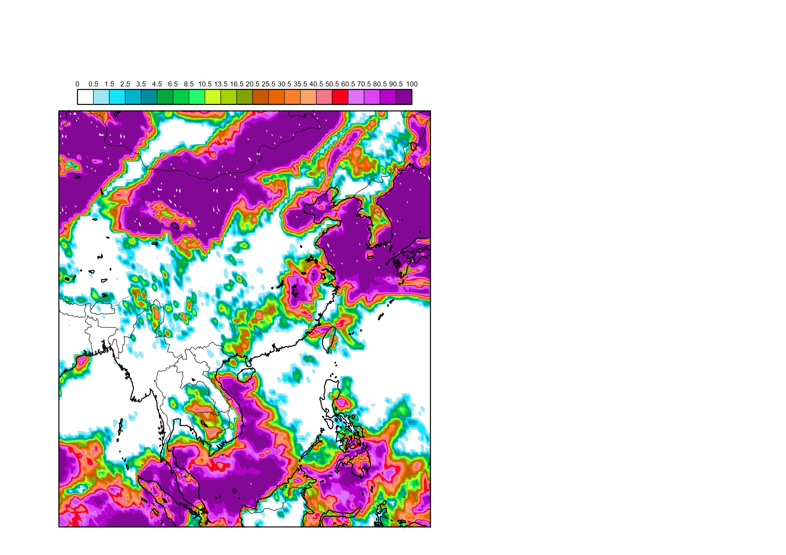
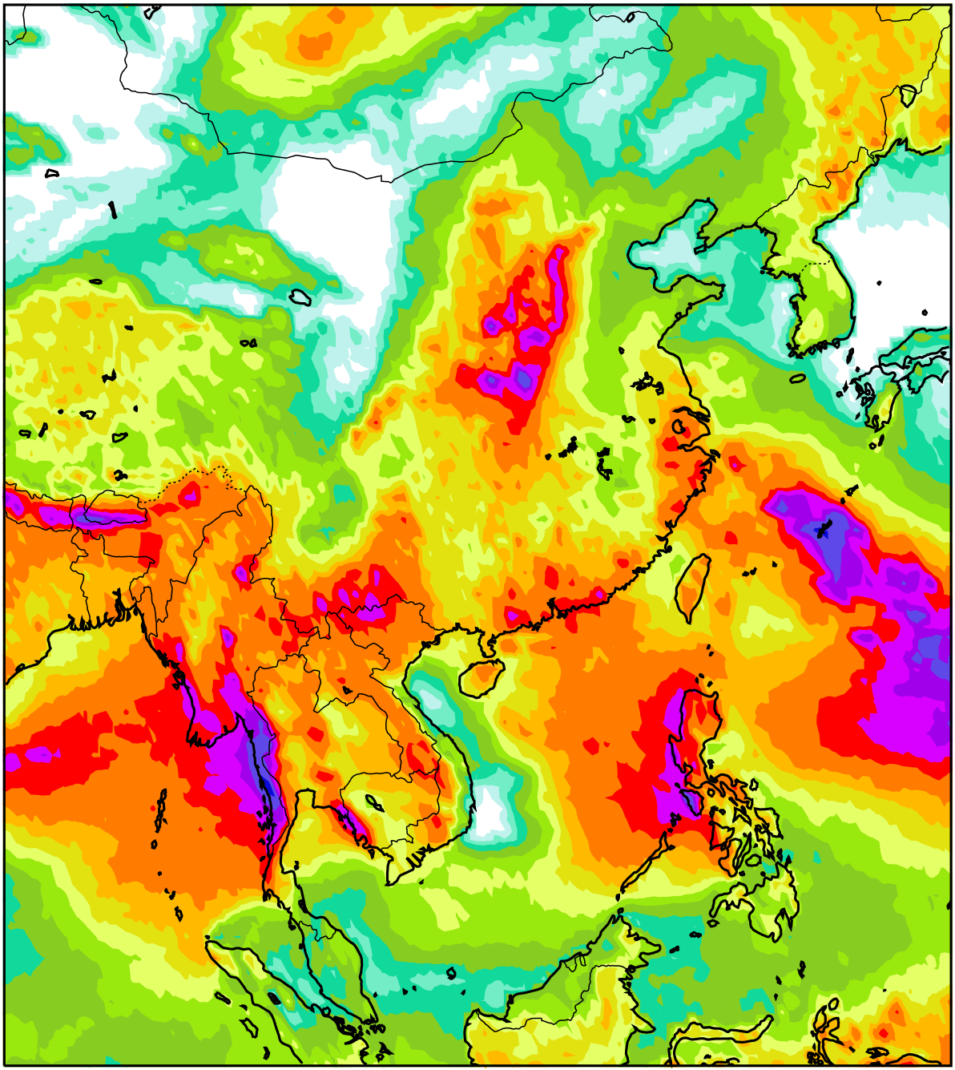
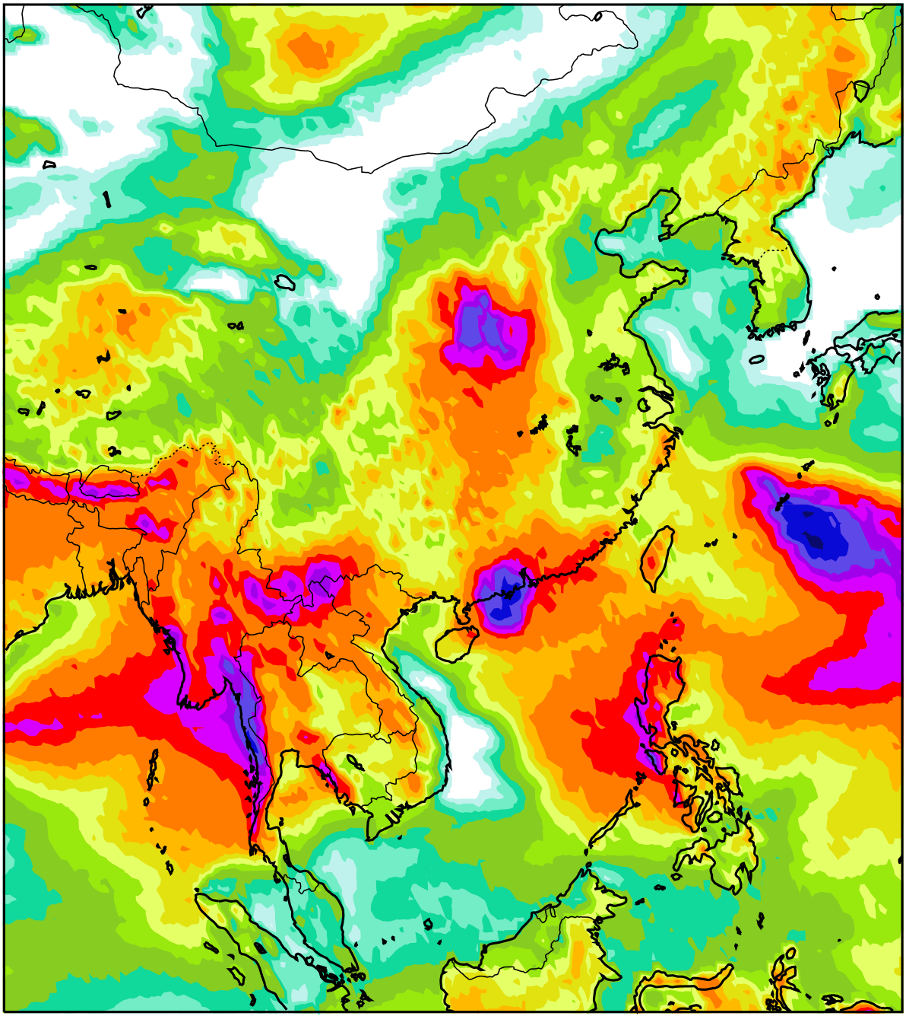
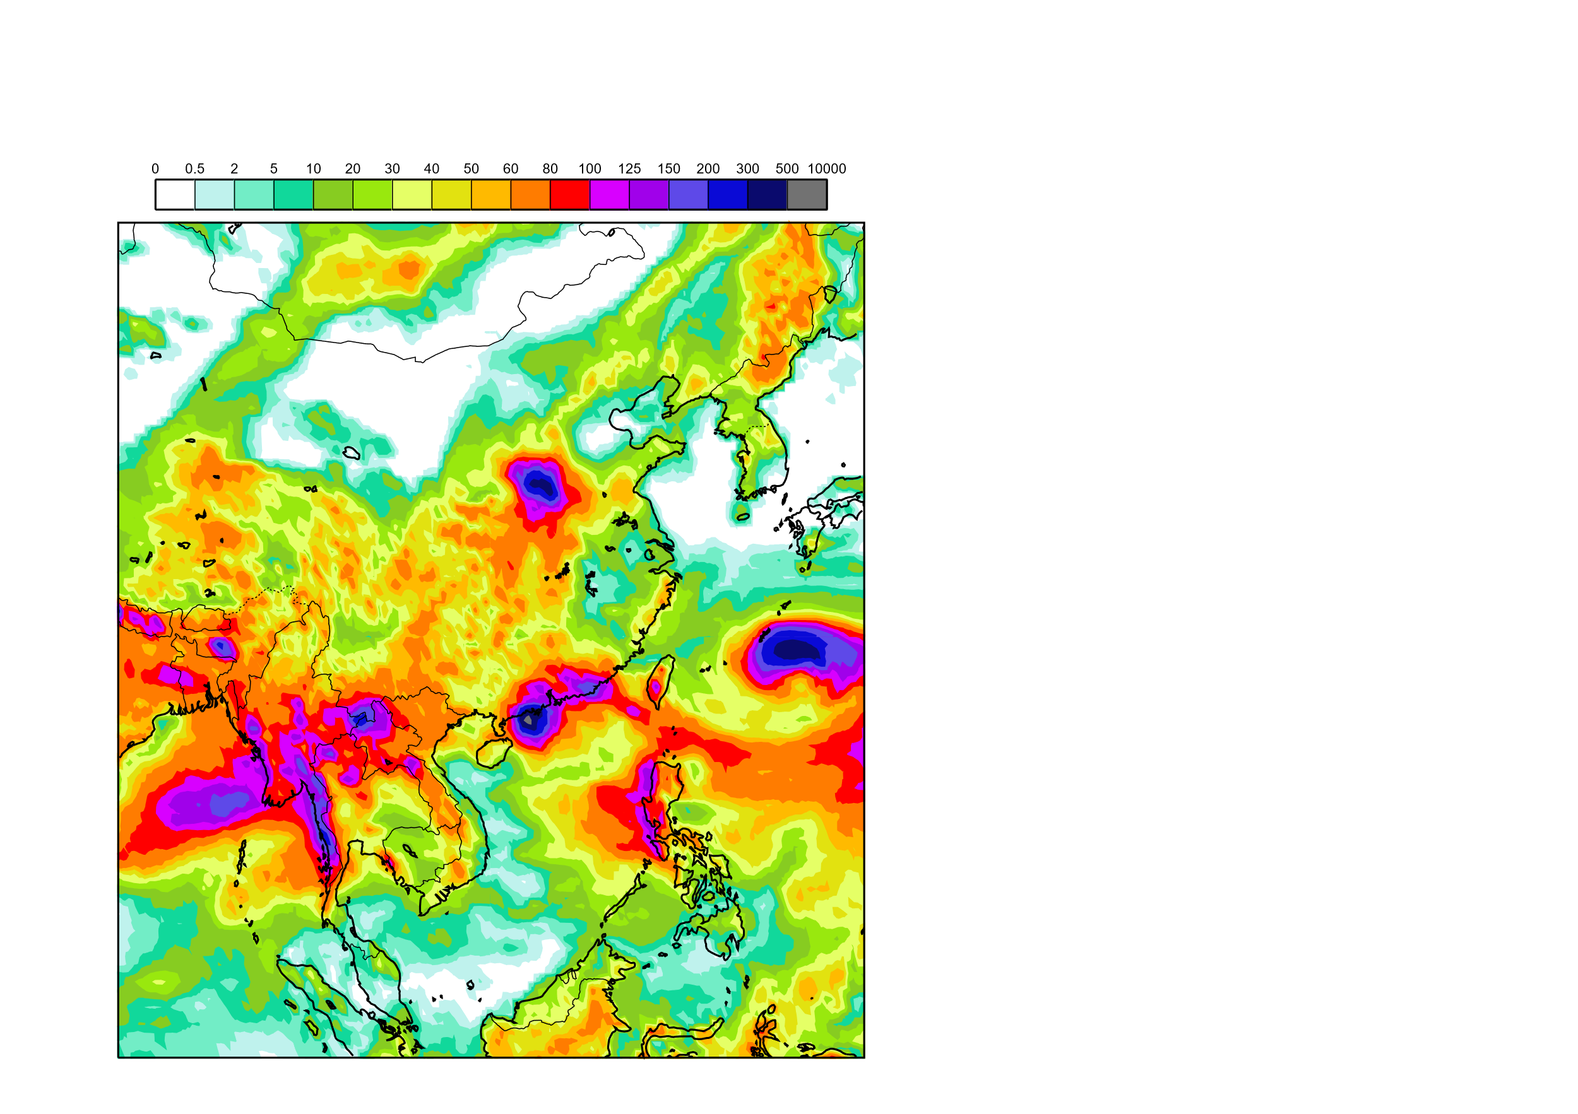
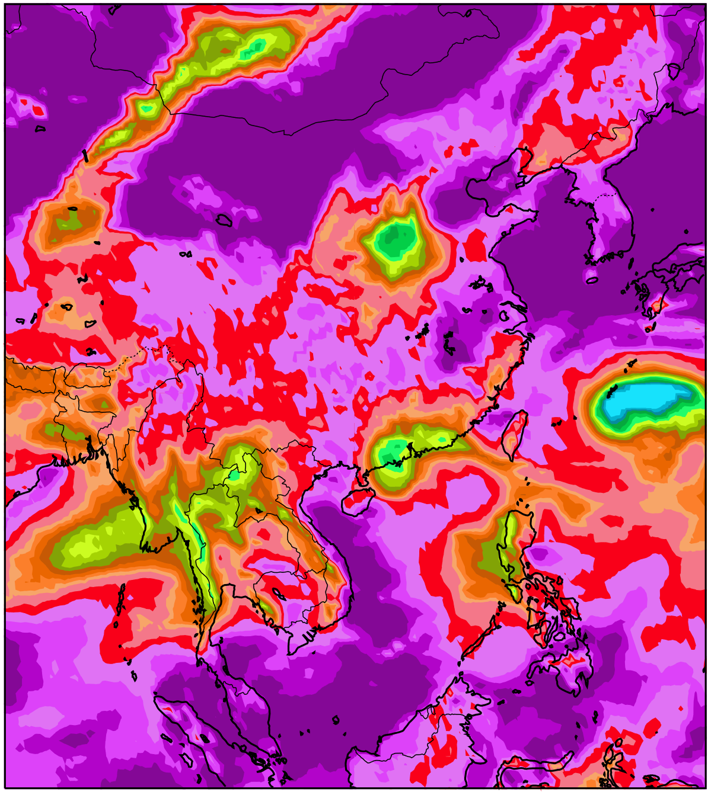
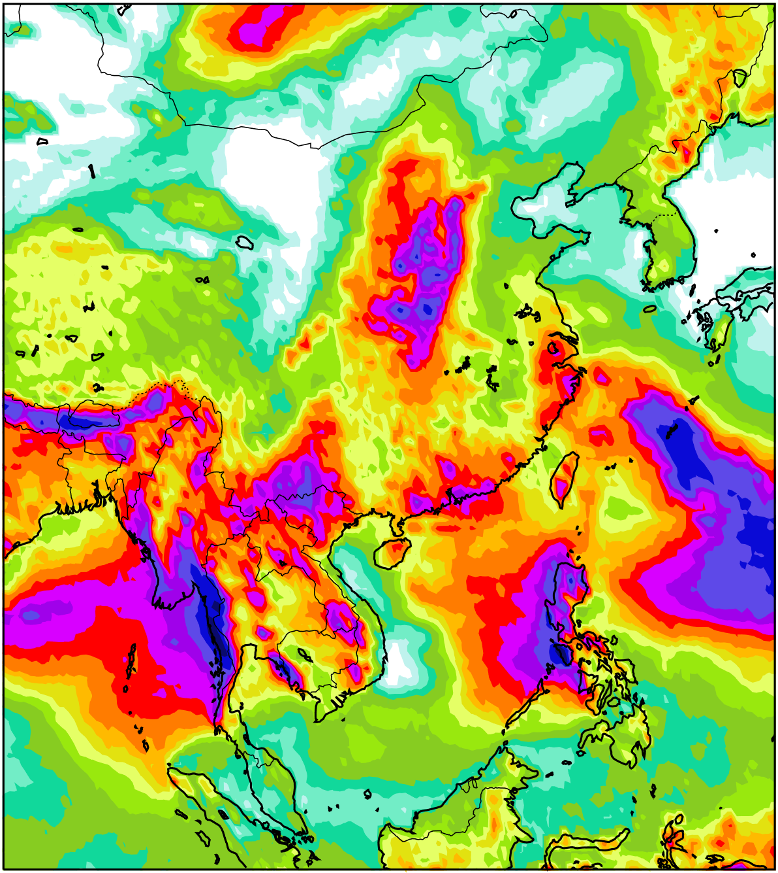
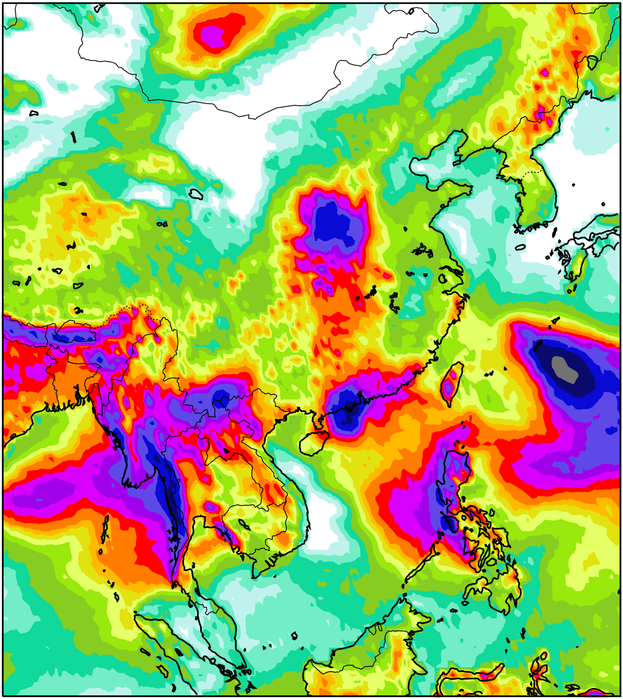
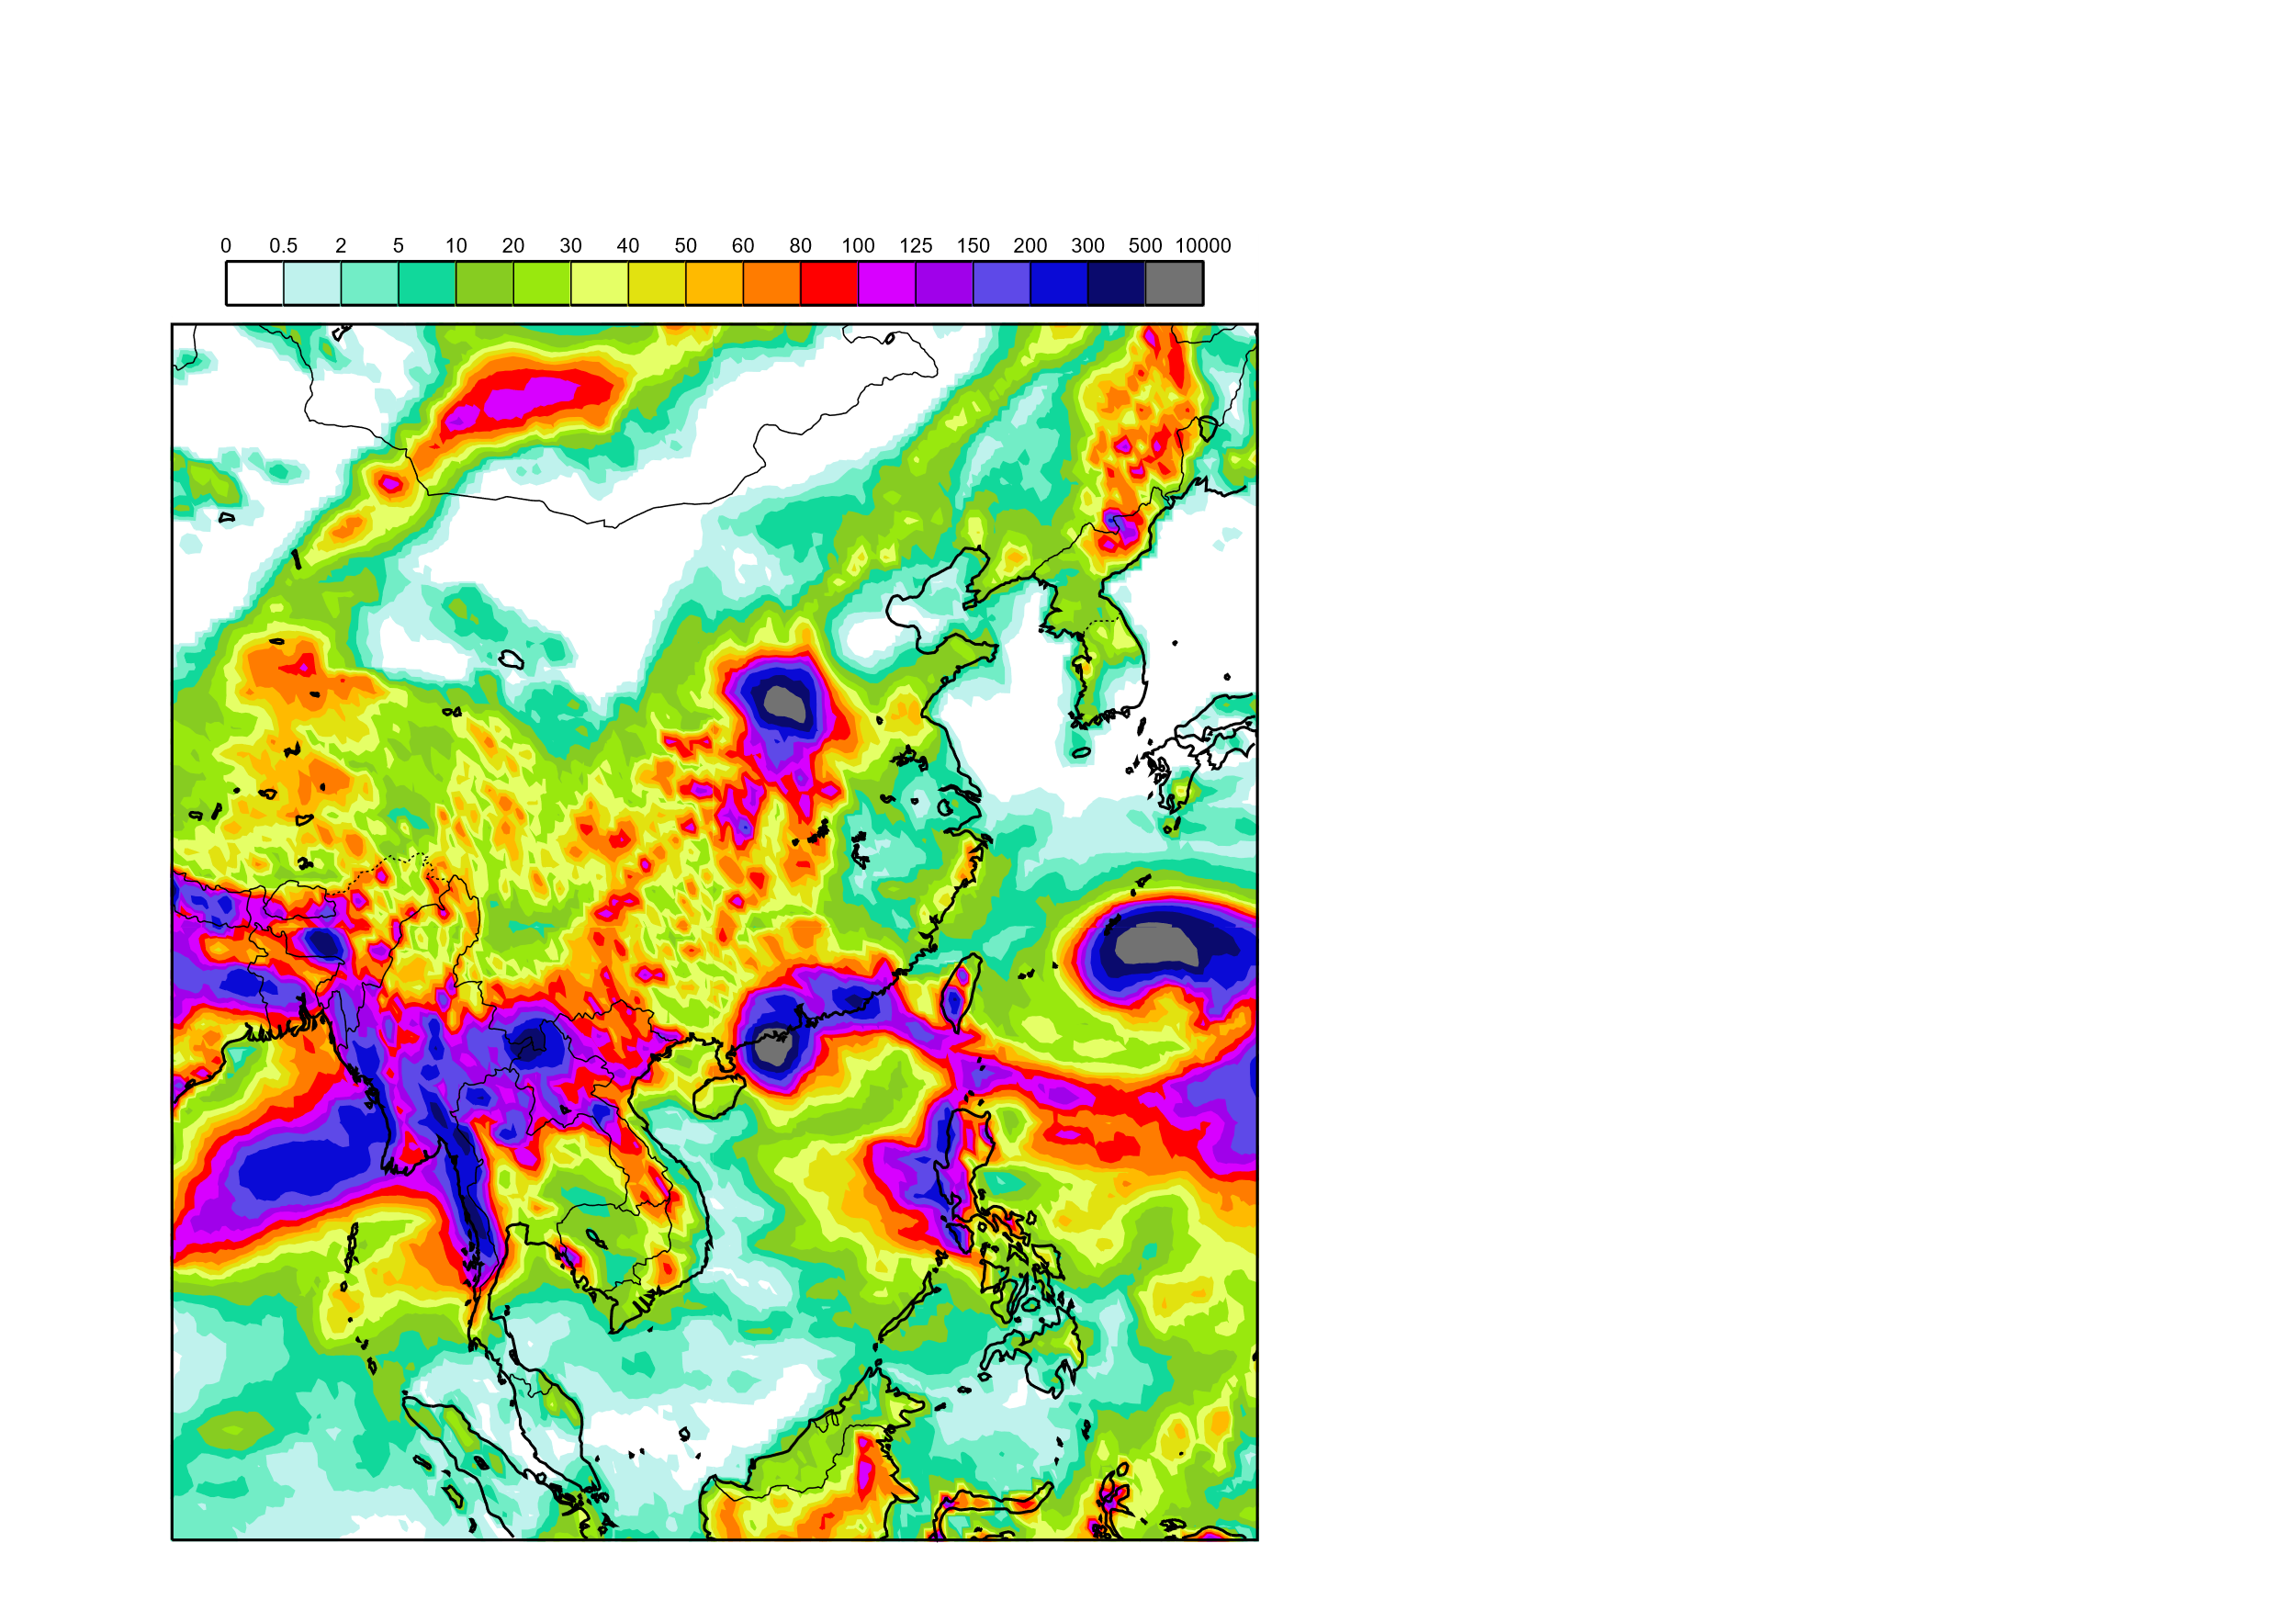
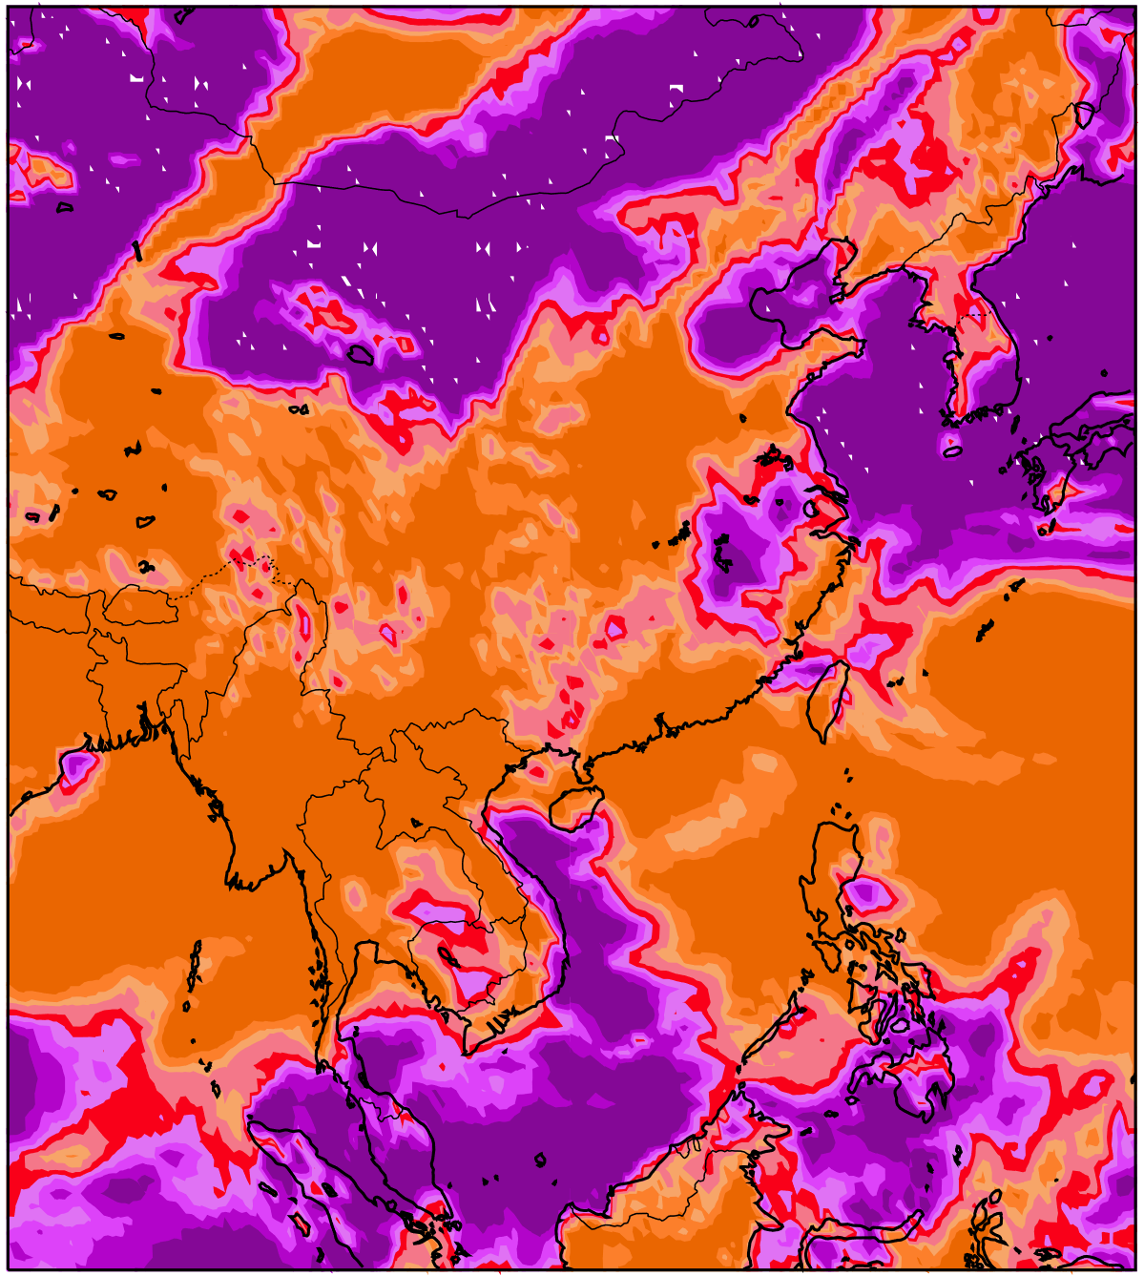
Zhengzhou (Henan, China) flash floods, 20th July 2021
12-hourly rainfall observations
Valid for 20th July 2021, between 0 and 12 UTC
1000
500
Zhengzhou
(465.8 mm/12h)
300
200
150
125
100
Rainfall (mm/12h)
80
60
50
40
30
20
10
5
2
0.5
0
99th percentile (wettest areas)
12-hourly rainfall forecasts
Valid Time: 20th July 2021 between 0 and 12 UTC
mm/12h
Prob <= 0.2 mm/12h
(driest areas)
%
ENS
Day5
Day3
Day1
Day1
100.5
90.5
80.5
70.5
60.5
50.5
40.5
ecPoint_MultipleWT
35.5
30.5
25.5
20.5
16.5
13.5
10.5
ecPoint_SingleWT
8.5
6.5
4.5
3.5
2.5
1.5
0.5
0

